Slide 1
Open Source Platform and Network Administration
Lesson 27

Slide 3
Monitor That Virtualized Hardware
Red Hat Virtual Machine Manager for managing virtual machines
Graphical interface available through virt-manager

Slide 4
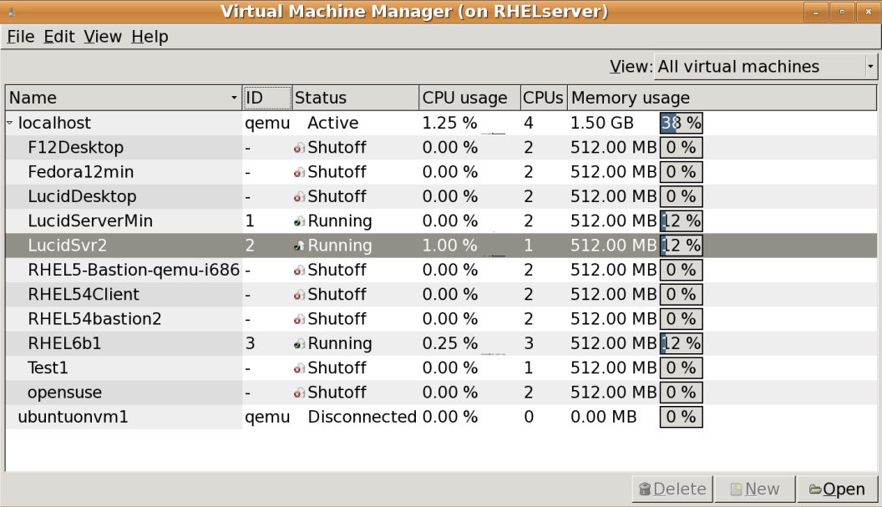
Virtual Machine Manager

Slide 5
Open Source Testing Tools
Wireshark
Snort
Netcat
Metasploit
Hping2
Notes:
Wireshark—Supports analysis of network packets
Snort—An intrusion detection system (IDS) with modes for packet analysis, logging, and interaction with iptables firewall rules; associated rules are updated on a regular basis
Netcat—A utility that can read both TCP and UDP packets
Metasploit Framework—A platform for testing for code designed to take advantage of known vulnerabilities
Hping2—A command-line packet analyzer that sends TCP and UDP packets based on the features of the ping command

Slide 6
Commercial Testing Tools
Nessus
SAINT

Slide 7
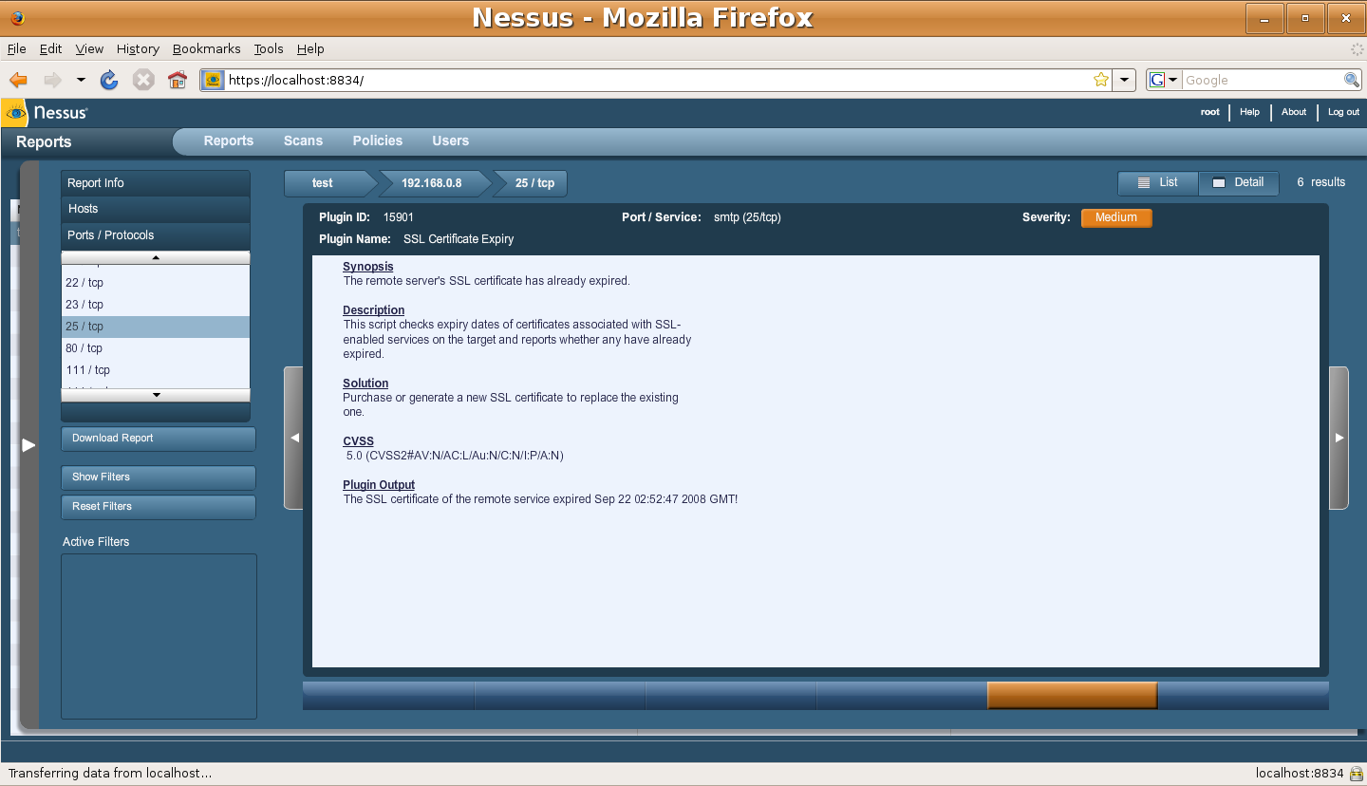
An Excerpt from a Nessus Report

Slide 8
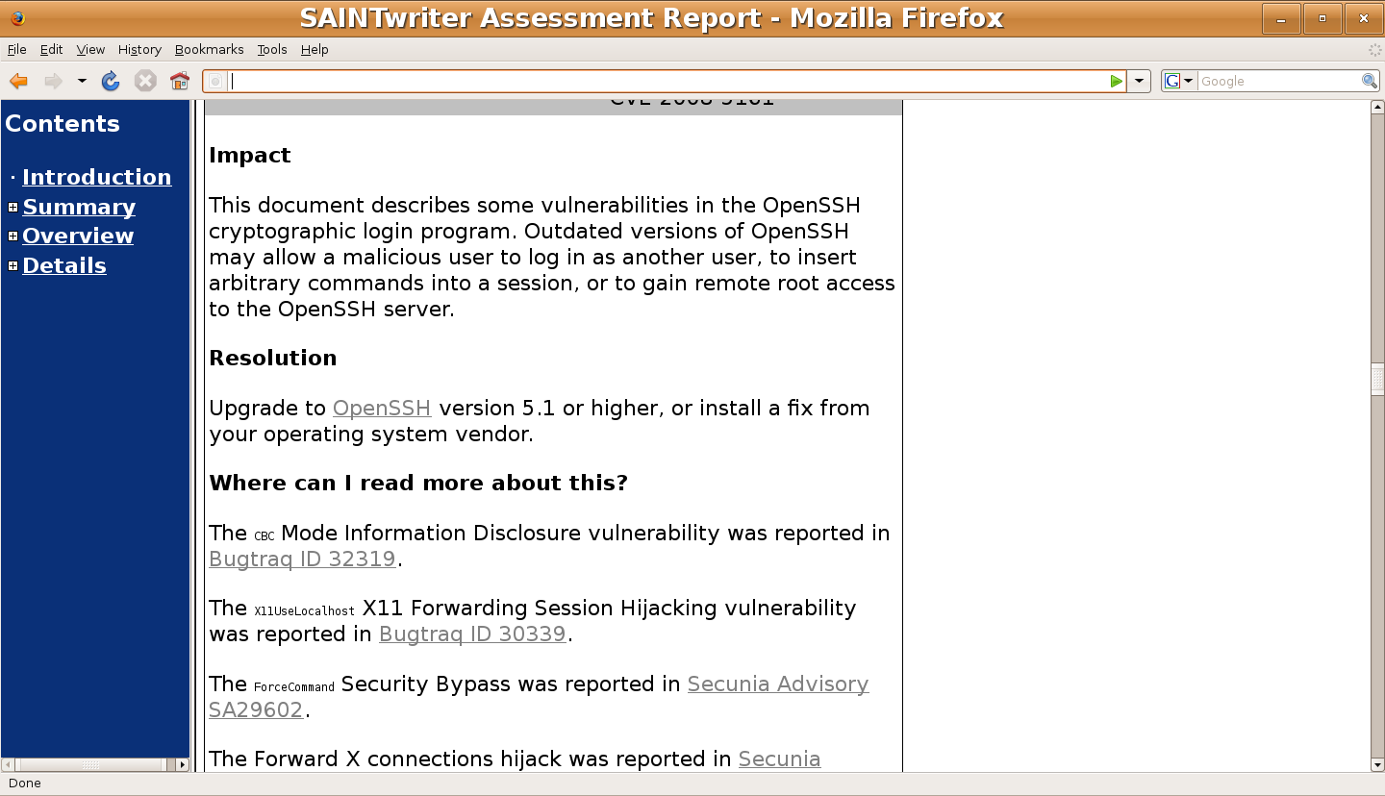
An Excerpt from a SAINT Report

Slide 9
The Right Place for Security Tools
On a secure system
Run from a live CD/DVD
Live tools:
BackTrack
Knoppix Security Tools Distribution (STD)
Network Security Toolkit (NST)

Slide 10
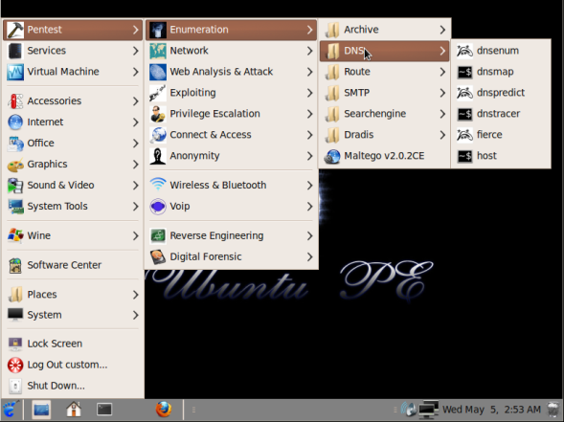
Ubuntu Pentest Edition

Slide 11
Summary
Security testing tools
Tools to monitor open ports
Security management on physical and virtual systems
Reporting features in common tools

Slide 12
Port Monitoring and Log Configuration
Port monitoring:
Indexes and monitors ports
Investigates unauthorized ports
Log configuration:
Configures logs on local and remote logging servers and runs log scanners, such as logwatch

